Slide 1
How to be a Demanding Diplomat
Fighting for the best available
care in an unaware system
Galen Warden • February 9, 2024
Notes:
Hello
Bateman Horne comes up whenever resources
and support for ME are mentioned
so I’m very proud to be here with you today.
Today we’ll look at tactics to improve your experience with providers
from medical services to transport to caregivers.

Slide 2
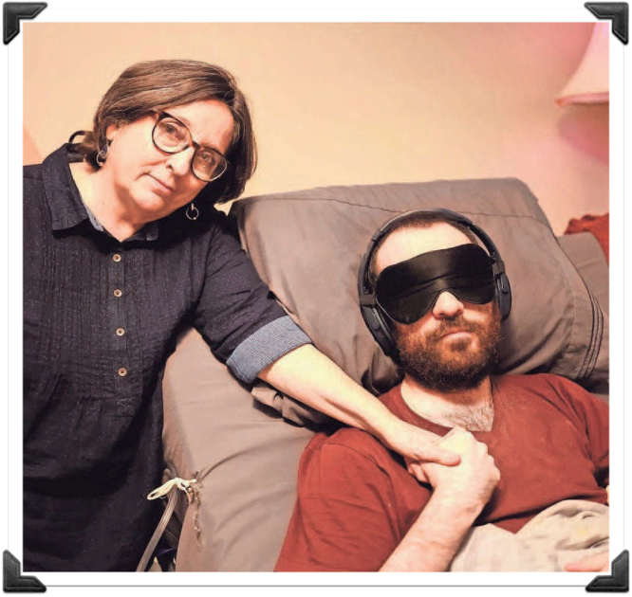
Agenda
Importance of logistics for severe ME
Medical Power of Attorney
Disability
Transportation
Accommodations at medical appointments
Caregiver support
Notes:
My goal is to educate you regarding some of the logistics of
caring for someone with ME, especially severe ME, like my son James.
I hope to spare you unnecessary stress.
You’re battling a many-headed hydra when you’re dealing with ME,
so I want to give you some tactical wins you can be proud of.

Slide 3
Importance of logistics
Every detail matters for severe ME
One misstep can lead to a lower baseline
No one else will understand the risk of ignoring extreme accommodation needs
Be kind and educational, but demanding.
Notes:
The doctors, caregivers, and transportation providers
we need are very likely not familiar with ME.
Our requirements seem over-the-top, so we might have to be insistent or demanding.
BUT if you educate people about your needs with kindness and patience,
your providers will gladly accommodate you as much as they can.
In this photo, James is waiting for an appointment in a room that’s under construction.
I went in ahead of him and asked the receptionist if there was any quiet place to put him.
I told her he has a severe neurological condition.

Slide 4
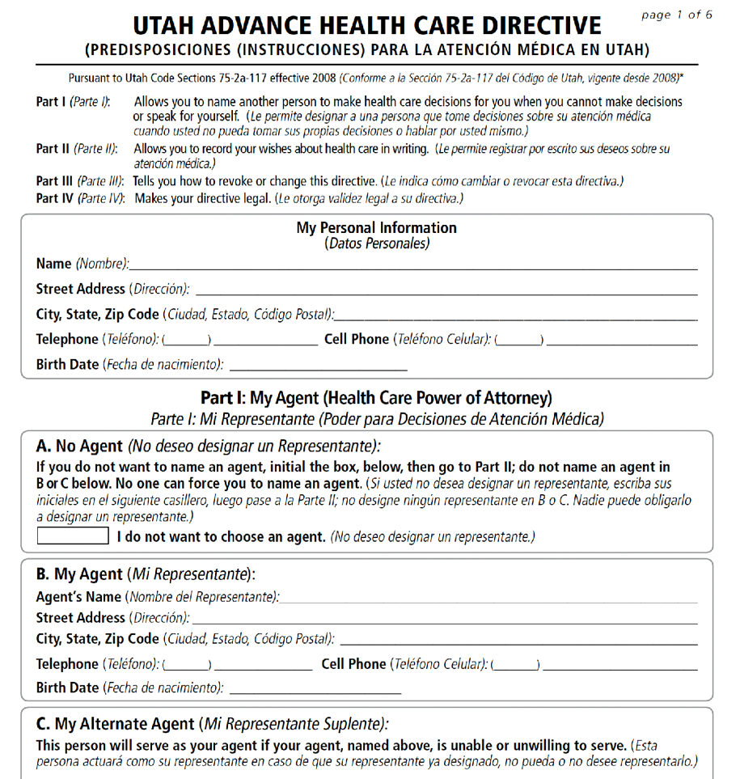
Health Care Power of Attorney
Not financial
No lawyer needed
Necessary for speaking to doctors about, or on behalf of, an adult
Easy to fill out
For Utah form, scroll down at: www.severemecfs.com/resources
Notes:
You need a Healthcare Power of Attorney or Proxy if you don’t have one.
Janet Dafoe, Whitney Dafoe’s mother, told me to do this as soon as possible.
I didn’t understand the importance, until I did it.
All of my interactions with medical people became way easier.
You won’t have to put them on the phone to give permission to speak to you. Simply say,
Check the file. I’m their Healthcare Power of Attorney. It’s ok to speak to me.
I encourage you - if you don’t have one, get it, fill it out, provide it to all of their doctors and providers, anyone that might use HIPPA, to put into their file.
I posted the Utah form on my website so you can go there to download it if you live in Utah.

Slide 5
Disability
Two kinds of disability: SSDI (Insurance) SSI (Income)
Do I need an attorney?
What if the medical assessment isn’t accepted?
What is the appeal process?
Notes:
If they don’t have it, everyone with ME should apply for one of these:
SSDI is Social Security Disability INSURANCE.
You’re eligible if you are disabled and have paid into Social Security
with enough years of qualifying work.
SSI is Supplemental Security Income. You qualify if you’re disabled
and have a low-enough income.
An attorney can help you with SSDI, but won’t help you with SSI.
SSDI pays a lump sum retroactively.
If you started to be disabled three years ago, but just got approved,
that back-pay could be substantial. Lawyers are happy to help you with SSDI
because they’ll take a percentage of that payout.
SSI has no back payment. No lump sum. Lawyers won’t help you because they won’t get a payday.
HOWEVER, anyone applying for disability can appoint a representative - a family member, anyone. That person can do the paperwork and if you appeal twice and go to court,
they can represent you like a lawyer would.
My son was rejected the first time - although he was bedbound - because the nurse practitioner who did his clinical evaluation said he could walk if he wanted to, even though she’d been coming to my house, and had never seen him do it.
So for my appeal, I sat down with a different nurse practitioner and thoroughly educated her on ME before she evaluated my son. I gave her print outs from the CDC and NIH websites, and she did a great job. He was approved about two weeks later.

Slide 6
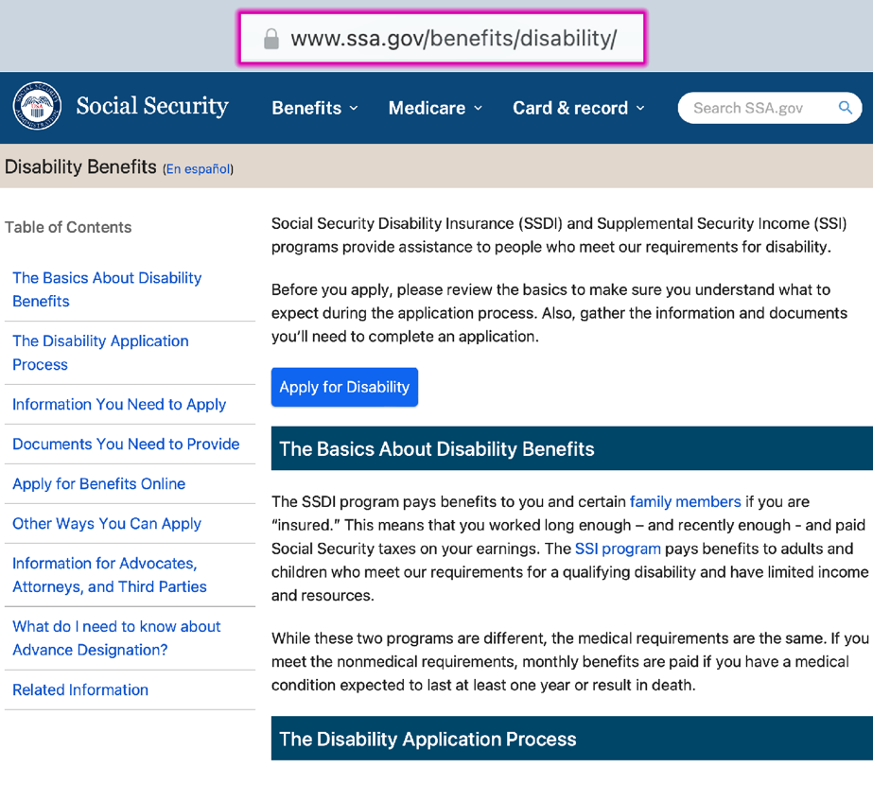
Applying for Disability
Notes:
This is the Disability website at ssa.gov /benefits/ disability
You need a Social Security website log-in to do all of this.
On this first page you can explore helpful information.
Click Apply for Disability to get to the second screen with more information.

Slide 7
Transportation
Non-urgent wheelchair or gurney transportation
Medicaid and Medicare cover this
medicare.gov/coverage/ambulance-services
Private providers also available
Notes:
For my bedbound son, transportation is by far the greatest challenge to receiving care.
I’m writing a book about our experience in a desperate attempt to stop
mild ME and long covid from becoming severe and wrecking millions of lives.
So I say this with very great intention:
If they don’t use a wheelchair, you should still rent one from a medical supply company for hospital visits.
Arrange for non-urgent medical transportation to the appointment so they can stay in the wheelchair in the van, and you can push them down those long hospital corridors.
My son is bedbound so he always travels by gurney.
Medicaid covers an unlimited number of these rides.
Medicare pays for limited non-emergency ambulance transportation if you have a written order from your doctor stating that the transportation is medically necessary.
Actually we have to do this once a year for Medicaid as well. The doctor writes the note and they have it on file - Yes - he needs this, so we use it.
If you happen to not have either Medicare or Medicaid, or you haven’t figured all of this out yet to be approved, you CAN hire private non-urgent medical transportation, but it’s very expensive out-of-pocket. The ride from my house to MUSC is $2500.

Slide 8
Transportation
Accommodations for protection
severemecfs.com/post/gurney-guide
Notes:
For my son’ severe ME, I meet the transport people outside,
describe how they need to interact with my son - for example:
Minimal speaking,
Support his neck and head - He cannot help at all, you do all the work to lift him -
I ask them to minimize noise inside the van.
Turn off any sounds they can - OR drive in such a way to avoid the back up alarm.
If your person has severe ME, please check out my Gurney Guide on my website.
People have found it to be helpful.

Slide 9
Accommodations at Appointments
How to speak about severe ME
Prepping a medical office
Minimizing exposure to harms
Music off
Special waiting area
Instructions if separated
Notes:
Unless it’s the general practitioner or nurse practitioner, responsible for the person’s care,
I have stopped going into detail about what ME is.
It’s a rabbit hole and you need service now - with the right accommodations.
You’re not there to educate beyond what is urgently required.
They have a severe neurological condition.
Turn off the music piped through the office.
Find a quiet place to await the appointment.
Avoid bright lights.
Minimize speaking.
This is the hardest. I speak with doctors in the hallway,
explain that processing words is very difficult for him,
Anything you can arrange to spare them stimulation or exertion
improves their chance of getting through the day without a crash or a lower baseline.
These are the stakes.
Those are large notes I put right on James when they took him in
for general anesthesia for an MRI.
They did great - I showed up to find him waking up with his mask and headphones on.

Slide 10
For Doctors who Don’t Know
In 1969 the WHO classified Myalgic Encephalomyelitis as a post-infectious neurological disease.
Chronic Fatigue Syndrome (CFS) is an unfortunate nickname from 1989 which stuck. ME/CFS is used to make sure it’s recognized.
Diagnostic code is G93.32. According to the CDC, 90% are not diagnosed. Medical education is lacking, but that is changing because millions are becoming disabled from Covid post-infectious ME, or Long Covid. (my son has Long Mono)
Send interested doctors to: www.cdc.gov/me-cfs/
Notes:
Unless it’s the general practitioner or nurse practitioner, responsible for the person’s care,
I have stopped going into detail about what ME is.
It’s a rabbit hole and you need service now - with the right accommodations.
You’re not there to educate beyond what is urgently required.
They have a severe neurological condition.
Turn off the music piped through the office.
Find a quiet place to await the appointment.
Avoid bright lights.
Minimize speaking.
This is the hardest. I speak with doctors in the hallway,
explain that processing words is very difficult for him,
Anything you can arrange to spare them stimulation or exertion
improves their chance of getting through the day without a crash or a lower baseline.
These are the stakes.
Those are large notes I put right on James when they took him in
for general anesthesia for an MRI.
They did great - I showed up to find him waking up with his mask and headphones on.

Slide 11
Caregiver Support
Medicaid & Medicare caregivers
medicare.gov/coverage/home-health-services
Private resources - care.com
Interview process
Training materials - instructions
Tasks and tracking - notebook
Notes:
If you have Medicaid, speak to your case manager about getting a caregiver.
They have a list of agencies in your area.
It’s a very stressful process to find someone, but it’s absolutely necessary.
Make a profile - a list of qualifications
Care and support for 32 year old with severe neurological condition.
Condition excludes physical exertion by patient.
You will gently assist with any movement needed.
Caregiver must work to limit: noise, bright light, scents (lotions, hair products),
animated actions, and all unnecessary speaking.
Duties include: household tasks such as laundry, food preparation, light cleaning up,
as well as caring for the patient as needed – bed bath, clothing change, sheet change, etc.
A quiet, calm, caring demeanor is required at all times.
For Training Materials You’ll want to print out your specific care instructions,
foods and preparation, toileting instructions, etc.
I include No unnecessary talking in every instruction.
I have a binder with tracking for each day someone comes.
When he got his pills, what he had for lunch, what time they did anything.
It’s a lifesaver because you’ll want to look back to see
what might have made them crash or given them abdominal pain.

Slide 12
Be the mother they need.
Notes:
Fighting for your child does not mean being hysterical or panicking.
It means thinking strategically - what’s your goal? Keep reminding yourself of your goal.
Letting someone know how upset you are and how your person suffers is a natural instinct, but not effective.
They’ll write you off. You need to win them over.
Remember that the person on the phone is not against you.
They are trying to do a job. Make their job easier any way you can.
Acknowledge that you are a special case and your accommodations might take some effort.
DO NOT go into long explanations.
Get their name. Write down everything they say. Every name someone mentions.
To get a private room for in-hospital stay, you might need to speak with the Patient Advocate at the hospital.
They might refer you to a Disability or Special Needs Advocate.
Sometimes it’s like following breadcrumbs through the forest
but eventually you’ll get the results you need.

Slide 13
More Information
galenwarden.com or severemecfs.com
severemecfs.com/post/gurney-guide
severemecfs.com/post/you-need-a-caregiver
tiktok.com/@galenwarden
instagram.com/severemecfs
Notes:
Here are some places you can follow me,
If you’d like to keep up with my progress while I finalize my book.
My ticktock videos and blog have more information on all of today’s topics.

